Slide 1
Wildfire Impact in
North Platte, Nebraska
OVERVIEW
Small town in Lincoln County, Nebraska, population ~ 20000.
Analysis of wildfire occurrences around the town from 1963 onwards.
Creation of a smoke estimate to quantify the impact of wildfire smoke in the city.
Understanding trends in wildfire occurrences, geological impacts and future trends.
Modeling sociological impacts: Effects of smoke on Respiratory illnesses in residents.
Forecasting future trends and charting out guidelines for the local administration.

Slide 2
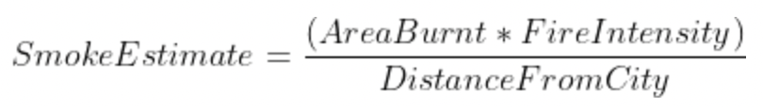
Wildfire & AQI Data Acquisition
Smoke Impact Calculation
Wildfire data from US Geological Survey (1963 onwards).
Filter to include data from up to 1250 miles from North Platte.
Around 100000 fires found.
AQI Data from US Environmental Protection Agency.
No gaseous data found, only particulate pollutants data.
Semantically quantifiable features used.
Geodetic Distance of the Fire from city.
Area burnt by the Fire.
Fire Intensity (type)

Slide 3
Wildfire & AQI Data Acquisition
Smoke Impact Calculation
Wildfire data from US Geological Survey (1963 onwards).
Filter to include data from up to 1250 miles from North Platte.
Around 100000 fires found.
AQI Data from US Environmental Protection Agency.
No gaseous data found, only particulate pollutants data.
Semantically quantifiable features used.
Geodetic Distance of the Fire from city.
Area burnt by the Fire.
Fire Intensity (type)

Slide 4
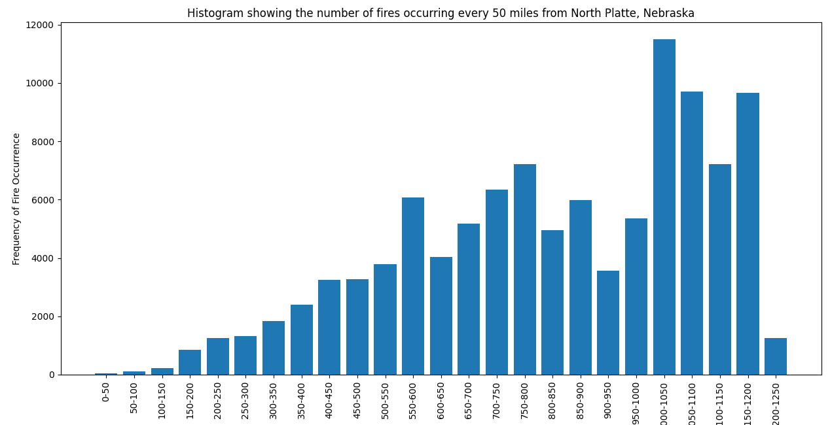
Wildfire Impact Analysis
How far from North Platte are wildfires occurring?
Takeaways: Lesser fires closer to the city, a positive trend.

Slide 5
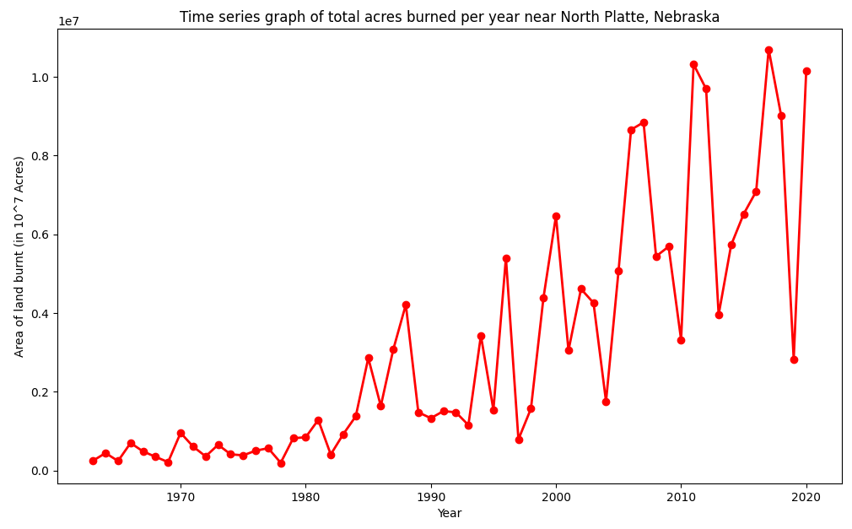
Wildfire Impact Analysis
2. How much land area are wildfires burning through?
Takeaways: Noticeable increase in area burnt across time, a negative trend.

Slide 6
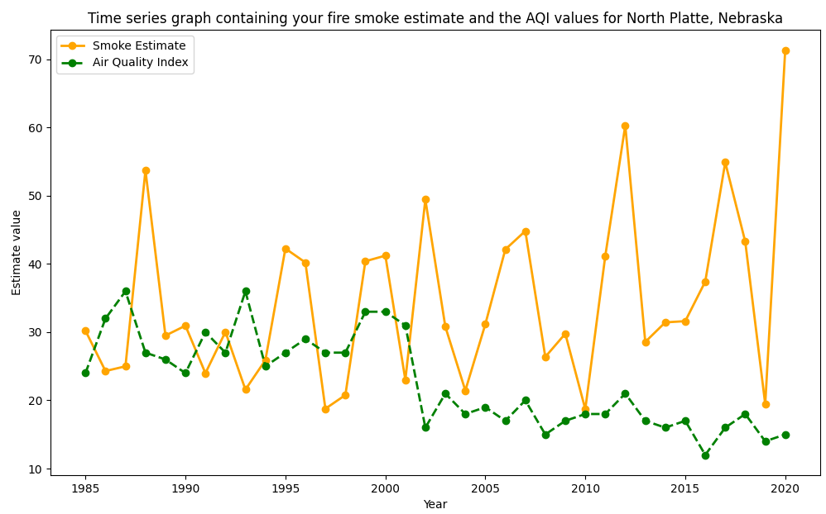
Wildfire Impact Analysis
3. How does smoke impact correlate with Air Quality Index?
Takeaways: Air quality is improving with time.
Smoke impact is gradually increasing and could be detrimental.

Slide 7
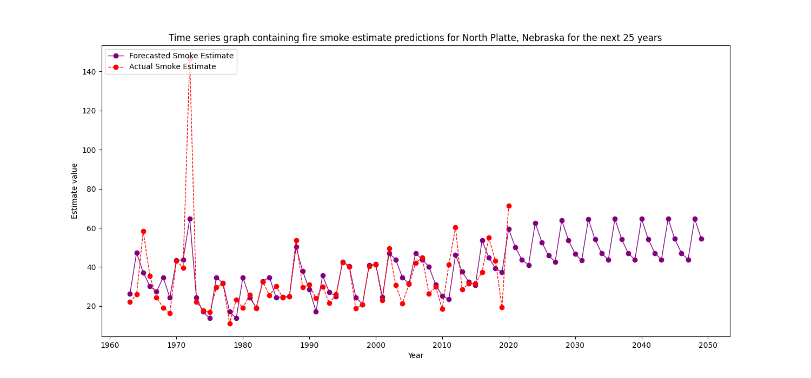
Wildfire Impact Forecasting
4. What could the smoke impact in future years look like?
Takeaways: Smoke Impact will gradually increase, with seasonal cycles.

Slide 8
Sociological Impacts of Wildfire: Healthcare
Wildfire smoke can affect the health of the residents.
Respiratory illnesses such as Bronchial Cancer and Tuberculosis could be caused by air pollution.
Trying to find correlations between smoke estimates and lung cancer occurrences.
Population (census) data for North Platte from 1990 onwards obtained from Nebraska Revenue Dept.
Cancer and Tuberculosis cases data from 1990 onwards obtained from the Nebraska Public Health Inventory reports.

Slide 9
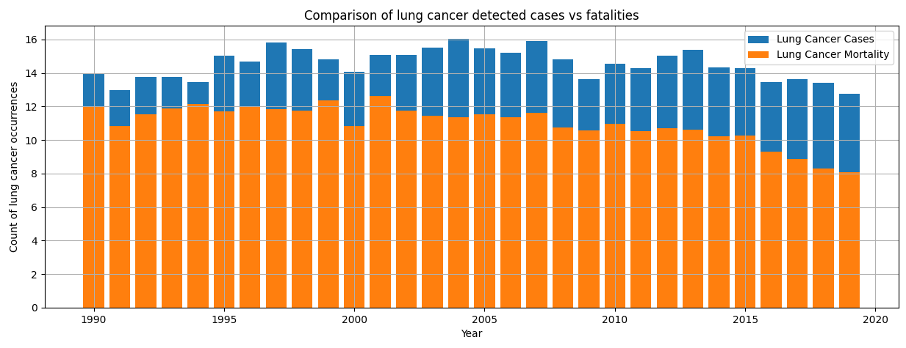
Lung Cancer Occurrence Trends
What do lung cancer cases in North Platte historically look like ?
Takeaways: Both lung cancer diagnoses and mortality rates are falling in recent cases.
The mortality rate in general is a high percentage of total cases.

Slide 10
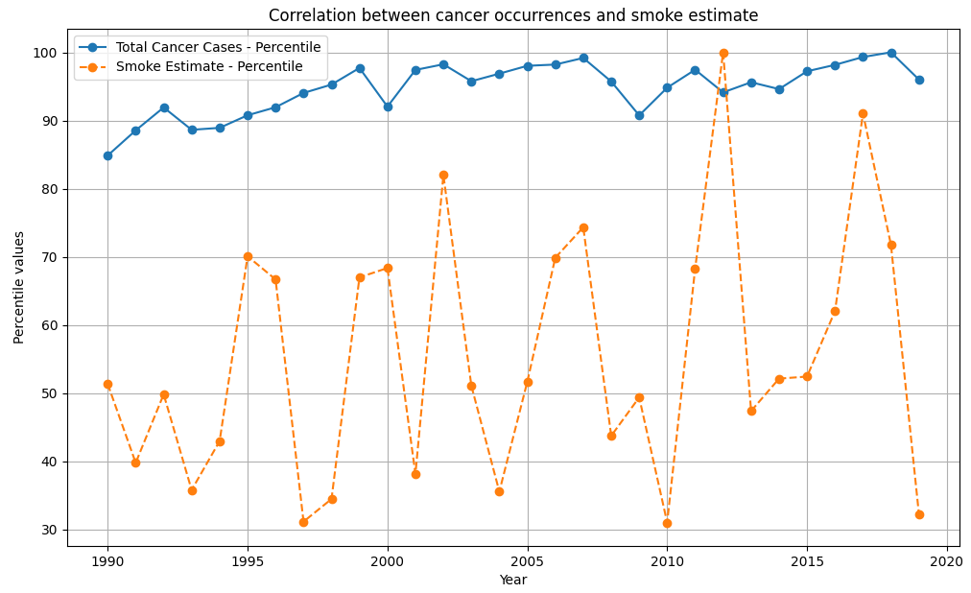

Wildfire Smoke Impact on Cancer Occurrence
Is there any correlation of smoke estimate with total cancer cases?
Takeaways: There is some visible similarity, and the correlation score of 0.32 confirms positive correlation between smoke estimate and cancer cases.

Slide 11
Conclusions and Recommendations
We can see that wildfire related smoke in North Platte is forecasted to increase in the coming years.
The local administration needs to put measures into place to curb wildfire occurrences: clear vegetation, safe landscaping and maintain firebreaks.
Early detection and rapid response to wildfires can prevent them from affecting North Platte seriously.
Develop and use fire-resistant materials in construction to reduce the vulnerability of buildings to wildfires. (Green urban urban planning)
Develop community plans that consider wildfire risk, ensuring that structures are built and located to minimize vulnerability.

